Slide 1
Sentiment Forecasting Of Political Party
Analyzing Public and News Media Sentiment Over Time
Under the guidance of: Prof. Saurish Dasgupta

Slide 2
1 : Introduction & Problem Statement
Political sentiment, especially during key events like the 2014 Elections, Demonetization, and GST rollout, shapes how parties like the BJP engage with the public. This project analyzes sentiment trends from 2013–2018 using tweets and news articles to explore the interplay between public opinion and media narratives.
However, the lack of labeled data, noisy social media content, and contextual complexity of news pose major challenges. We address this by:
Developing sentiment scoring pipelines using pretrained models (BERTweet, VADER, BiLSTM+BERT).
Forecasting sentiment trends via time-series models (pRT+, Informer).
Predicting sentiment score of any headline that comes from any news
Comparing public vs media sentiment to uncover patterns, fluctuations, and potential biases.

Slide 3
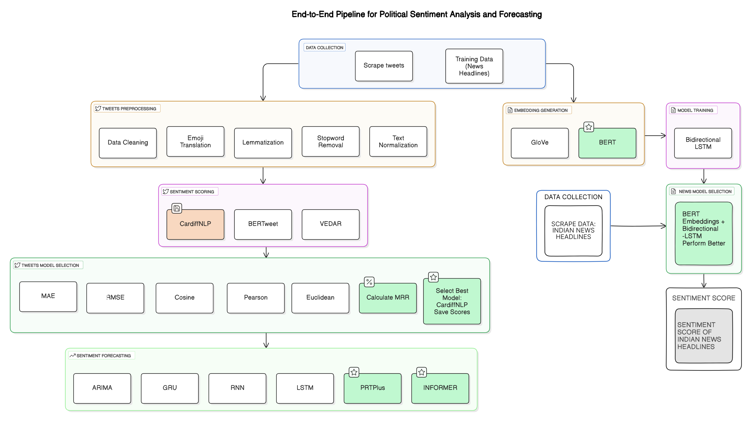
2 :End-to-end Solution Pipeline

Slide 4
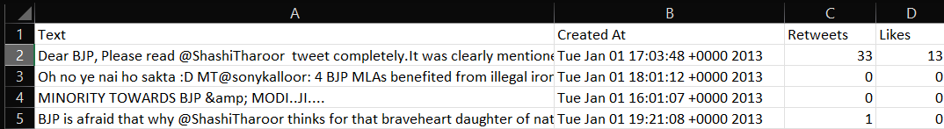

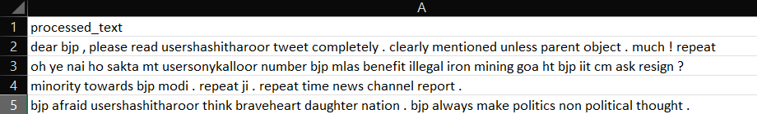
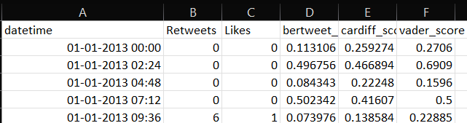

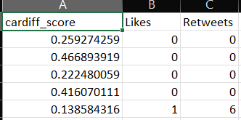
3.1 : Dataset – For tweet forecasting :
Original Scrapped Data
Pre-Processing
Pre-Processed Data
Applied Pre-trained model
3 Pre trained model’s sentiment Scores
Final Data
CardiffNLP was selected based on consensus metrics including MAE, RMSE, Euclidean Distance, Pearson Correlation, Cosine Similarity
And CardiffNLP, with the highest MRR, was chosen as the optimal model

Slide 5
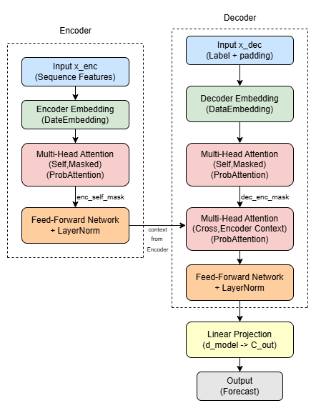
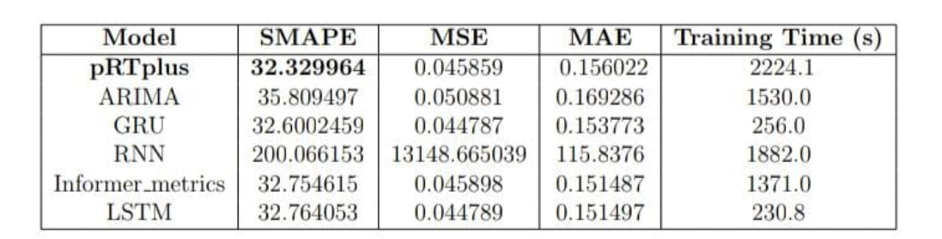
3.2 : Architecture & Its result :
◈Proposed Architecture
◈ Evaluation and SOTA comparison leaderboard:

Slide 6
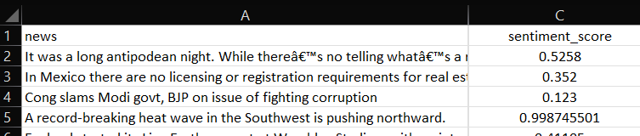
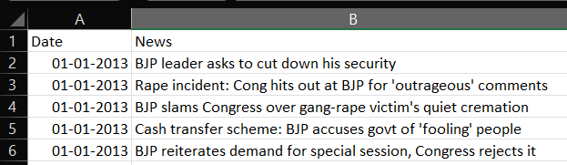
4.1 : Dataset – For news Sentiment prediction
◈ OBTAINED DATA
This data was used for supervised learning of our proposed model
◈ SCRAPPED DATA
This scraped data was used as an unseen data to predict or assign sentiment scores using proposed model

Slide 7
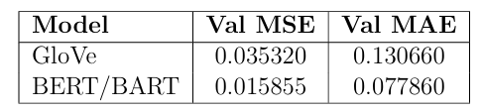
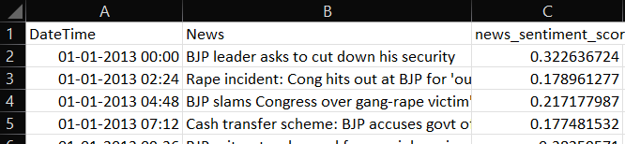
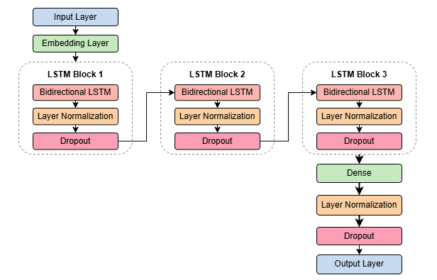
4.2: Architecture & Its result:
◈ Embedding Generation :
Two embedding strategies, GloVe and BERT, were used to represent news headlines. The BERT based model outperformed GloVe by achieving lower MSE and MAE on the validation set
◈ Predicted Sentiment scores on unseen data by proposed model :
◈ Proposed Architecture :

Slide 8
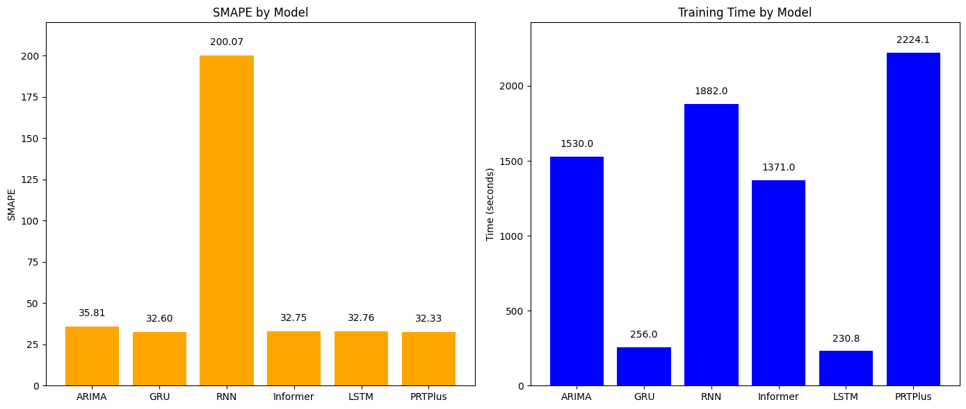
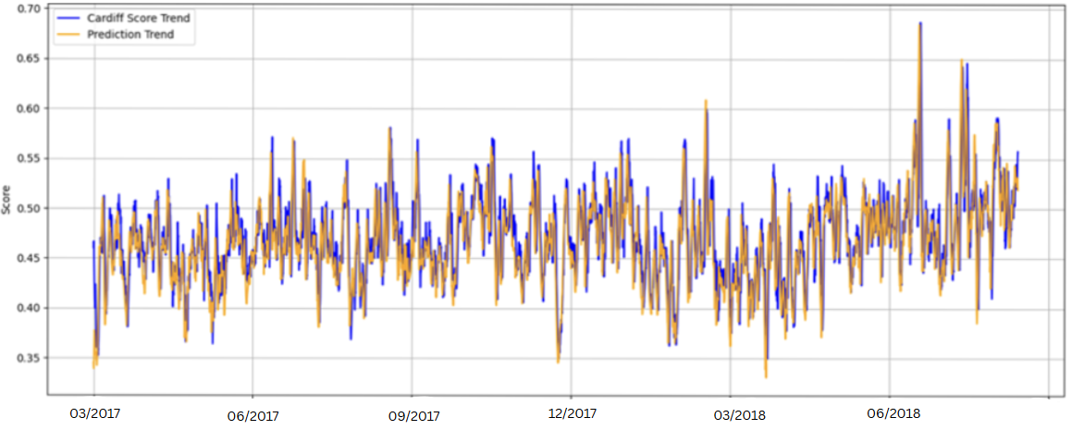
5 : Results & Analysis
◈ Analysis of Proposed model with SOTA
◈ Analysis of Tweet Forecasting:

Slide 9
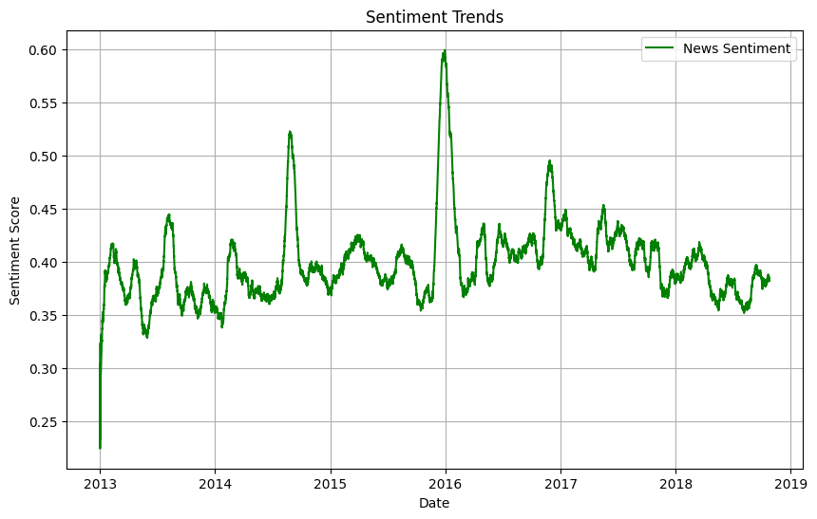
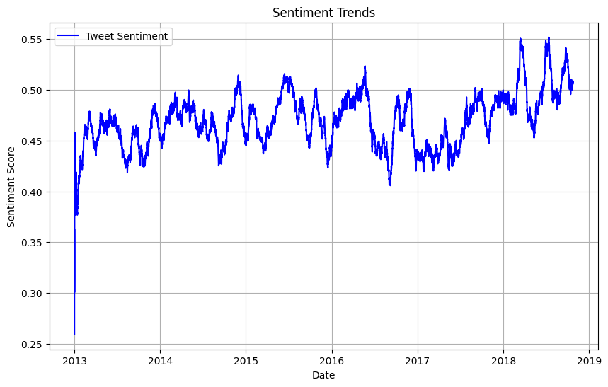
◈ Analysis of News Sentiment:
◈ Analysis of Tweet Sentiment:

Slide 10
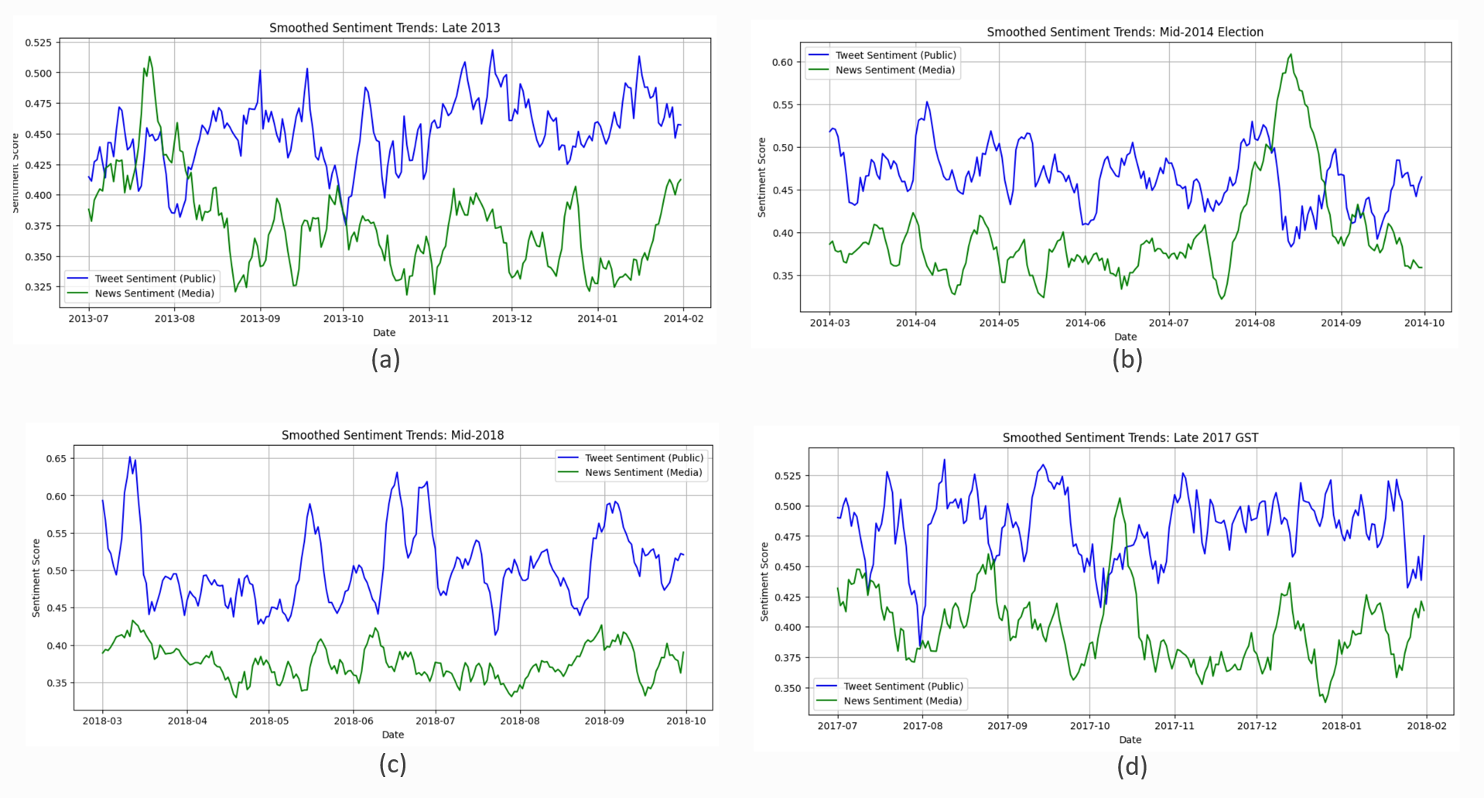
◈ Analysis of News vs Tweet Sentiment:

Slide 11
Thank You
Team members:
Milan Nagvadiya (202418035)
Krisha Sompura (202418026)
Sheetal Jain (202418051)
Yashraj Sinh (202418064)

